Slide 1
CHAP CHAP(Figma Project)
Designed [202410060]
“Simple, Fast & Tasty Experience.”

Slide 2
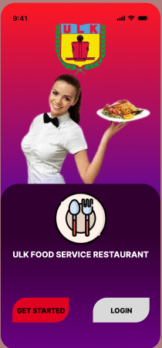
ABOUT THE APP
“The main goals of my design were:
To simplify the food ordering experience
To create an attractive and consistent UI
To improve navigation and user satisfaction
And to include useful features like favorites, order tracking, and easy checkout.”
Notes:
Image suggestion: Illustration of phone with food icons or Figma workspace snapshot.

Slide 3

Problem Statement
Long Wait Times
Confusing Order Process
Distractions and Line Cutting
Crowding and Lack of Space
Notes:
Image suggestion: Comparison screenshot (bad UI vs your clean design).

Slide 4
Objectives
> “The main goals of my design were:
Time-Saving Convenience
Easy-to-Use Interface
Multiple Payment Options
Scheduling & Pre-Ordering
Notes:
Image suggestion: Icons representing simplicity, design, tracking, and payment.

Slide 5
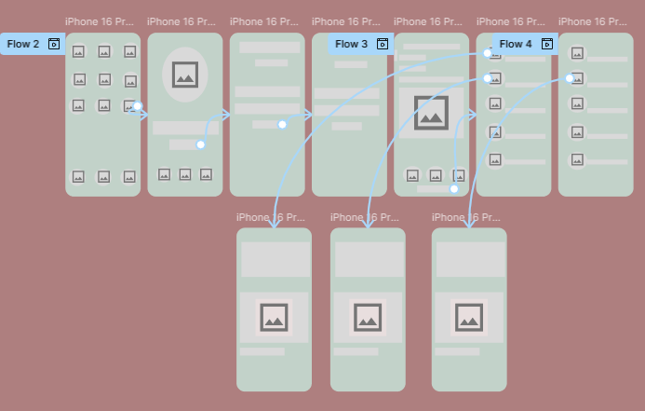

Slide 6
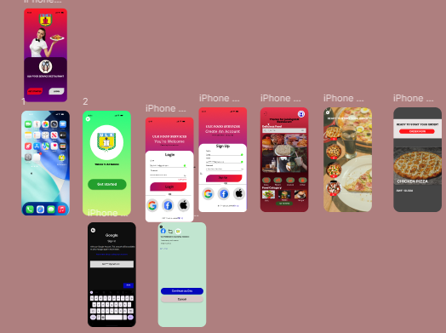

Slide 7
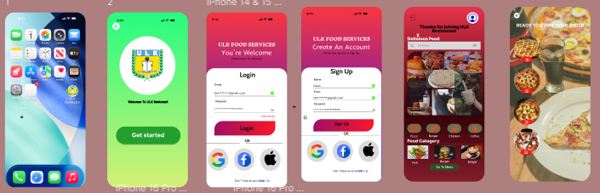
MOCK UP

Slide 8
Conclusion
My goal was to create a visually appealing and user-friendly food ordering app, and I believe this design achieves that.
Thank you for your attention!”
Notes:
Image suggestion: Closing slide with app’s main screen or contact info.

